Slide 1
Complexity and the Art of Public Policy: Solving Society’s Problems from the Bottom up
David Colander
College Professor
Middlebury College

Slide 2
Outline
Policy narrative lock-in and the Rise of Complexity Science
History of Economist’s Policy Narrative
An example of the type of policy initiatives that follow from the Complexity policy narrative.

Slide 3
Summary of Current Standard Policy Frames
Economics of Control Narrative: Constrained optimization, Max U
There is a general model of the market economy
Subject to certain assumptions, the market will achieve Pareto optimal outcomes
Government ‘s role is to allow the market to do what it can, but to maximize social welfare by correcting for market failures—externalities, monopolies.
These can be analyzed through models, and one draws policy conclusions from the models.
Mathematics and formal models are center stage—Samuelson’s Dictum—burn the prose.
Market Fundamentalist Frame
The market evolves. Externalities are all internalized by private individuals (Stigler’s version of Coase’s Theorem) so little government intervention needed.
Policy Debate is between Government Failure and Market Failure. Empirical evidence generally too weak to answer it so debate is unresolved in practice, but in principle, it could be resolved.
Notes:
Currently policy makers rely on two much simpler models— the standard policy model that sees the state as correcting market failures and the market fundamentalist model. In this state control model, the market works pretty well on its own, and it would work perfectly but for problems of increasing returns, monopoly and what are called externalities—results of decisions that do not affect the decision maker. That leaves a role for the state—to prevent monopolies and correct for externalities. That model dominates policy discussions; it is the way government policy is almost invariably thought about—government controlling the economy, correcting for externalities, adjusting the system for increasing returns, or regulating the economy by taxes or regulations. The basic policy mantra of the standard model is: We need government to make the system operate efficiently, like the standard model says it should.
The market fundamentalist model, on the other hand, integrates the evolutionary aspect of the economic system into its worldview. It sees the market economy as self-organizing and uncontrollable. But, from a complexity framework, it takes a too simplified view of that evolution. It sees the market as evolutionary, but, accepts the standard policy narrative’s assumption that the state is outside the evolutionary system. The result is that market fundamentalists see the state as attempting to do the impossible—to “control” the evolution, and almost as a gut reaction sees any state intervention as undermining the system. Thus, its policy conclusion is to keep the state out of the economy.

Slide 4
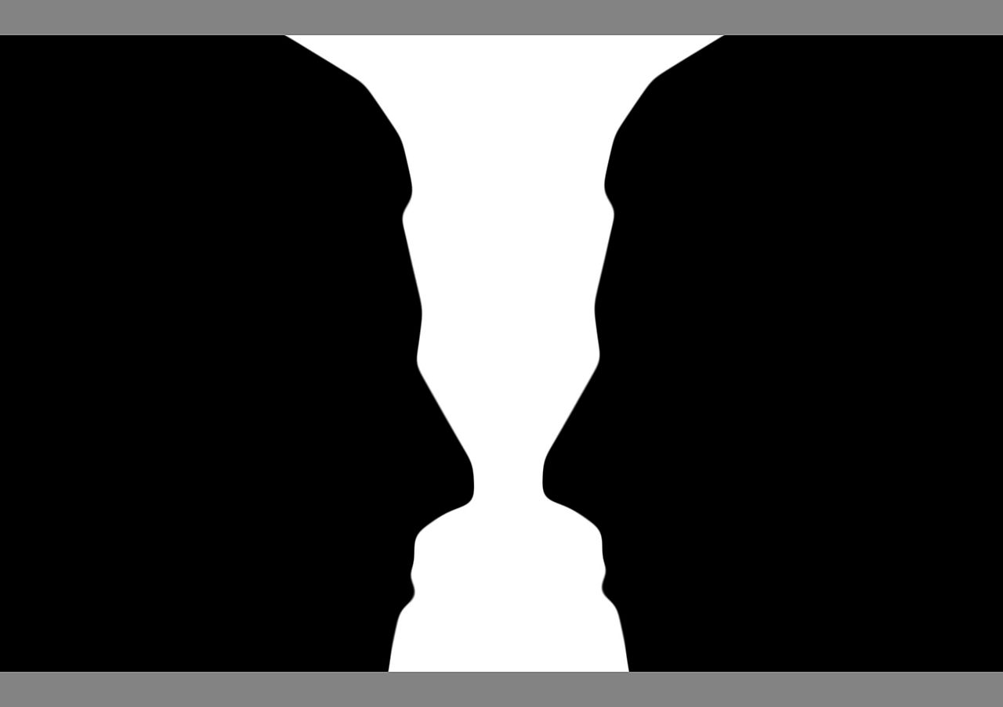
The Importance of Framing

Slide 5
The Rise of complexity science
dispersed interactions among locally interacting heterogeneous agents,
no global controller who could exploit opportunities resulting from these dispersed interactions,
cross-cutting hierarchical organization with tangled interactions,
continual learning and adaptation of agents,
novelty and mutations of the system
out-of-equilibrium dynamics.

Slide 6
Herbert Simon’s Definition of Complex System
"By complex system I mean one made up of a large number of parts that interact in a non-simple way. In such systems, the whole is more than the sum of its parts, not in an ultimate, metaphysical sense, but in the important pragmatic sense that, given the properties of the parts and the laws of their interaction, it is not a trivial matter to infer properties of the whole" (Simon, 1981, p.4).

Slide 7
Complexity economics
Complexity
General equilibrium
Closed systems
Neo-classical
Macro-economic models
Learning by doing
Path Dependency
Bounded rationality
Game theory
Open systems
Expectations
Agent Based models
Behavioural economics
Ostrom
Notes:
Game theory has replaced calculus as the core of micro.
Evolutionary game theory is redefining how institutions are integrated into the analysis.
Ecological economics is redefining how nature and the economy are viewed as interrelating.
Behavioral economics has changed assumptions of rationality to a much more nuanced view of individuals
Econometric work dealing with the limitations of classical statistics is redefining how economists think of empirical proof.
Complexity theory is offering a way of redefining how we conceive of general equilibrium.
Computer simulations are offering a way of redefining models and how they are used.
Experimental economics is changing the way economists think about empirical work.
Buy macro modeling still dominated almost exclusively by GE.

Slide 8
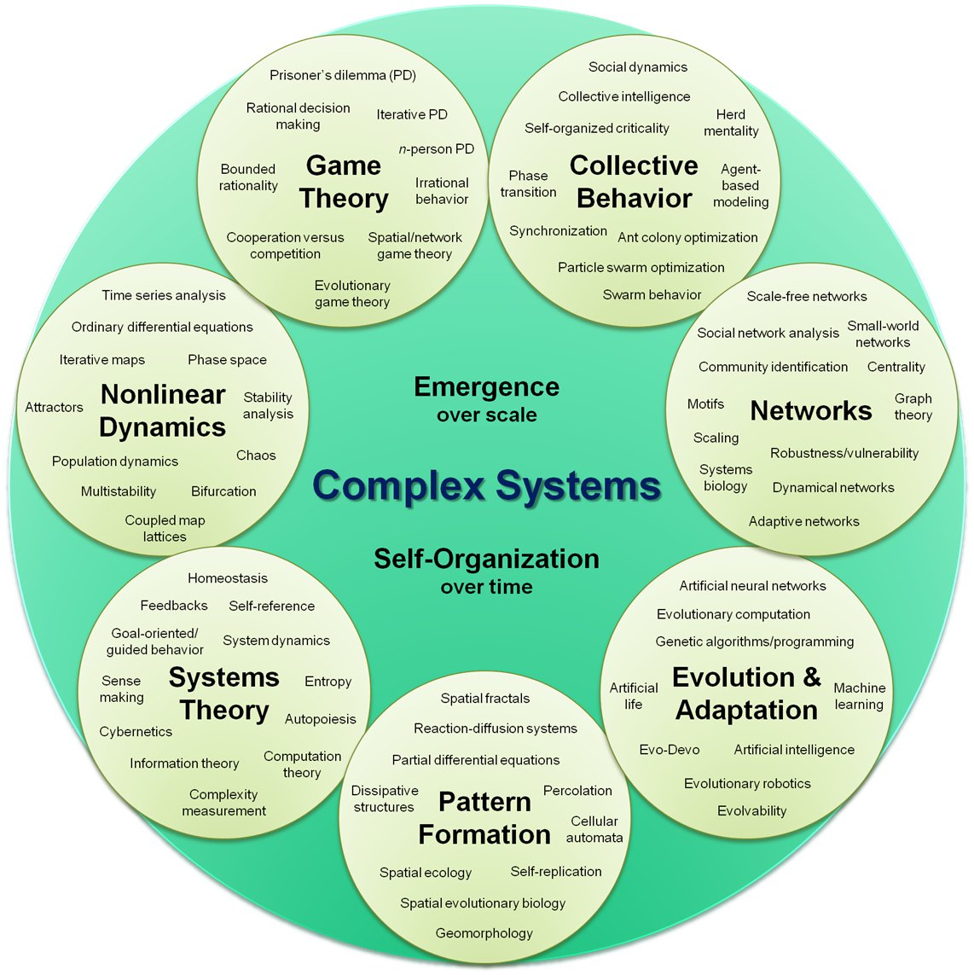
The Economy as a Complex Evolving System

Slide 9
Modern Economics is No Longer NeoClassical Economics
Game theory has replaced calculus as the core of micro.
Evolutionary game theory is redefining how institutions are integrated into the analysis.
Ecological economics is redefining how nature and the economy are viewed as interrelating.
Behavioral economics has changed assumptions of rationality to a much more nuanced view of individuals
Econometric work dealing with the limitations of classical statistics is redefining how economists think of empirical proof.
Complexity theory is offering a way of redefining how we conceive of general equilibrium.
Computer simulations are offering a way of redefining models and how they are used.
Experimental economics is changing the way economists think about empirical work.

Slide 10
The End of Neoclassical and The Rise of Complexity Theory in Economics
Micro—behavioral economics
Data analysis
Experimental
Evolutionary Game theory
Precise rationality no longer assumed
Agent Based modeling
Macro—DSGE opposite way, but reactions—DSGE model is way too simple

Slide 11
Leonard Read’s I Pencil Story Revisited: Government and the Market co-evolve
What made I Pencil’s story so compelling was how, when one looked carefully at the seemingly simple combination of wood, lacquer, printed label, graphite, metal, glue, and eraser that made him up, what one saw was actually a symphony of subtlety, all carried out without a conductor! Even though each person involved only knew a small part of the process—the invisible hand of the market combined the activities of hundreds of thousands of people into a magnificent process that created him, and, in even more complex ways, millions of products much more complicated than him. His story celebrated the creative energies of people that underlie our society’s wealth and happiness.
The “lead problem” raises another part of our family’s genealogy story that I Pencil didn’t discuss. This part of the story expands my genealogy enormously, and conveys and even more complex story of my production than did I Pencil’s. You see I Pencil focused his story on those people who had direct production descendants in production, and pointed out how some were far far removed from direct production---the people who made the machines who made the machines, etc. What he didn’t talk about were the indirect producers of his products. These indirect producers provide and maintain the institutional structure that makes it possible for the direct producers to do their job.
The reason these indirect producers are important is that modern production involves enormous amounts of indirect coordination just to maintain the institutional structure. If the indirect producers don’t succeed in providing an acceptable institutional context, the system will fall into chaos for lack of any coordination, or become so sclerotized, that they prevent new approaches from changing my production process.
Notes:
Can’t talk of one without the other
Efficiency of market has no meaning
Efficiency of system
That which exists is efficient
No fixed point with which to compare

Slide 12
The Complexity Policy Framework
The general model is too complicated to solve so in the complexity policy frame one has no general theory to rely on. The models are not enough.
Government has coevolved with the economy and cannot be viewed separately from the market.
Social norms co-evolve
There is no different fundamentalist and standard policy narrative
Mathematics (applied) and formal models are center stage, but are used a guides.

Slide 13
Implications of the Complexity Policy Framework for Economist’s Research
Theory becomes less important; applied work—solving real problems—becomes dominant—then generalize. (Two stories-streetlight and architect)
Economics of influence, not economics of control—since government and market have coevolved, and are interrelated, there is no outside controller.
Engineering, not scientific methodology guides.
Policy focuses on changing institutions rather than just incentives. Incentives are embedded in institutions. One role of policy is to explore institutional space to open up new areas for social entrepreneurs to populate.
Models and mathematics and models are to be used more in a Marshallian sense than a Samuelsonian sense. Mills dictum Integrate the math and the prose.
Policy is time and position sensitive. Focus on lock-in and tipping points—there is a right time and a right place for policy.
Policy is discussed as social policy—goes beyond economics, not economics policy; the two are inseparable.

Slide 14
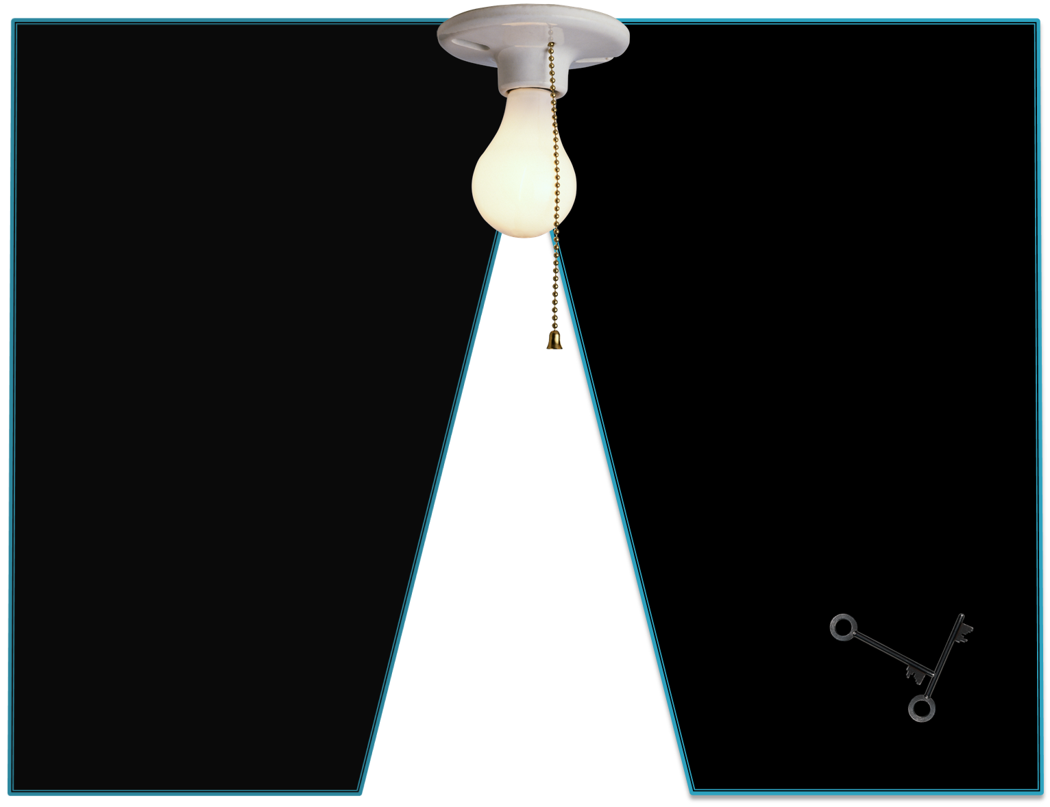
Theory and Models are Heuristics, not Truth: Punch line of Streetlamp joke
A person is walking home late one night and notices an economist searching under a lamppost for his keys. The person stops to help. After searching a while without luck he asks the economist where he lost his keys. The economist points far off into the dark abyss. The person asks, incredulously, “Then why the heck are you searching here?” To which the economist responds—“This is where the light is.”

Slide 15
Applied Policy becomes Engineering, not applied science
Difference between a scientist and an engineer
A scientist’s goal is to discover the truth.
An engineer’s goal is to solve a problem.
The scientific method which is a strategy to discover what is true and what is false.
The engineering method is to solve a specific problem.
"Engineering is quite different from science. Scientists try to understand nature. Engineers try to make things that do not exist in nature. Engineers stress invention. To embody an invention the engineer must put his idea in concrete terms, and design something that people can use. …Almost all engineers working on new designs find that they do not have all the needed information. Most often, they are limited by insufficient scientific knowledge.
Billy Vaughn Koen, who has written what appears to be the current standard methodological treatise for engineering defines the engineering method as “The strategy for causing the best change in a poorly understood or uncertain situation within the available resources.”

Slide 16
Models and theories become heuristics
A heuristic is defined as “anything that provides a plausible aid or direction in the solution of a problem but is in the final analysis unjustified, incapable of justification, and fallible.”
Four signatures of a heuristic—it does not guarantee a solution;
it may contradict other heuristics;
it reduces the search time in solving a problem;
its acceptance depends on the immediate contest instead of on an absolute standard.

Slide 17
The Central Policy Choice in the Complexity Frame
The central policy choice in a complexity frame is not—the market or the government. The goal of policy in the complexity frame is not to choose one or the other. Instead, policy is seen as affecting a complex evolving system that cannot be controlled. But while it cannot be controlled, it can be influenced, and policy makers have to continually think how to take advantage of evolutionary pressures, and try to guide those pressures towards desirable ends. Sometimes this requires top down control policies that work against those evolutionary pressures. But within the complexity frame, top down control policy is the last resort and suggests that you have failed in your previous attempts. The reason you would resort to it, is that the problems you are facing are seen as such systemic threats, and that you can’t wait for the slower, but more sustainable, bottom up policies to work.

Slide 18
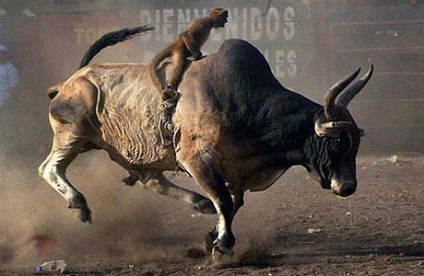
Control vs. Influence

Slide 19
The lost agenda
Polarity in policy debate
Confusing of outcome and dynamic
Misrepresentation of scientific foundation
Complexity frame opens new policy options
Economics of influence, not economics of control—since government and market have coevolved, and are interrelated, there is no outside controller.
Policy is discussed as social policy—goes beyond economics, not economics policy; the two are inseparable.
Policy focuses on changing institutions rather than just incentives. Incentives are embedded in institutions.
One role of policy is to explore institutional space to open up new areas for social entrepreneurs to populate.
Policy is time and position sensitive. Focus on lock-in and tipping points—there is a right time and a right place for policy.
Notes:
Economics of influence, not economics of control—since government and market have coevolved, and are interrelated, there is no outside controller.
Policy is discussed as social policy—goes beyond economics, not economics policy; the two are inseparable.
Policy focuses on changing institutions rather than just incentives. Incentives are embedded in institutions.
One role of policy is to explore institutional space to open up new areas for social entrepreneurs to populate.
Policy is time and position sensitive. Focus on lock-in and tipping points—there is a right time and a right place for policy.

Slide 20
Outline
Policy narrative lock-in and the Rise of Complexity Science
History of Economist’s Policy Narrative
An example of the type of policy initiatives that follow from the Complexity policy narrative.

Slide 21
Summary of the Classical Policy Narrative (up until the 1930s)
No formal general model of the economy and no direct connection between science and policy--interrelations too complicated—they had a general vision.
Policy was to come from broader considerations—Classical economists differentiated precepts—policy prescriptions including all considerations, and theorems—results of formal theorizing—no direct relevance for policy
In particular instances, economic reasoning may dominate, but for others it would not
Models are tools for solving particular problems.
Mathematics and formal models are downplayed—Marshall’s Dictum—burn the mathematics.

Slide 22
Classical Approach to Policy
(An economist’s) conclusions, whatever be their generality and their truth, do not authorize him in adding a single syllable of advice. That privilege belongs to the writer or statesman who has considered all the causes which may promote or impede the general welfare of those whom he addresses, not to the theorist who has considered only one, though among the most important of those causes. The business of a Political Economist is neither to recommend nor to dissuade, but to state general principles, which it is fatal to neglect, but neither advisable, nor perhaps practicable, to use as the sole, or even the principle, guides in the actual conduct of affairs. (Senior 1836: 2-3)

Slide 23
How economics lost the complexity vision in macro and micro
Complexity vision was Classical liberal vision. Lost in the mathematics of the Walrasian neoclassical revolution. Marshall followed a classical liberal vision and his models were to be used with judgment.
For Classical liberals all policy was an art—for neoClassicals, policy was science.
Understanding of constrained optimization and coordinating role of prices—overtook the policy discussion
Economics of control:
Market worked—except for market failure, but government could correct those.
Market fundamentalism developed in response to that—government failure
Entire discussion of government providing ecostructure for free individuals to evolve was lost to the policy discussion.

Slide 24
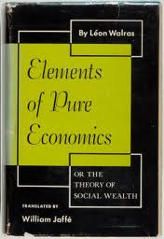
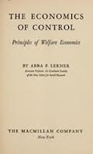
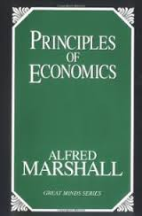
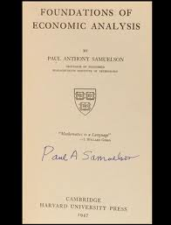
How Complexity got Pushed out of Micro
Movement from Classical to Marshallian to Walrasian Neoclassical Economcis to Welfare theorems
Lerner’s Economics of Control

Slide 25
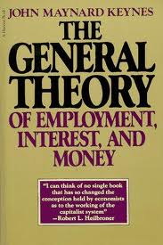
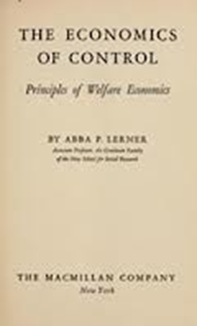
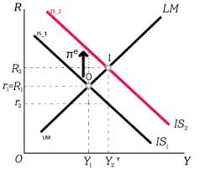
How Complexity Got Pushed out of Macro
Keynes introduced complexity, it was lost by neoKeynesians, and Keynesian policy came to mean something quite different than Keynes meant.

Slide 26
What got pushed out
· Neither side questioned the role of norms in policy. Instead both sides of the argument accepted that norms were not part of the debate. This is where the contribution of the other social sciences is sorely missed.
• Neither side questioned how the activities that individuals undertook could feed back on what the people wanted and shape them as a person. Both sides assumed that people had well-formed tastes and that the tastes are not affected by what they do or their context. That just isn’t true—what we want is influenced by the system, and any policy advice would have to take into account the degree to which that occurs. This opens up a whole range of policy actions that are generally not considered.
• Neither side questioned the assumption of perfect rationality, and how policy might deal with irrationality, or at least more bounded rationality than assumed by the standard model.
• Neither side questioned the problems with material welfare as a measure of welfare—problems that were much on the minds of Mill, Marshall and Pigou. Whereas before economists separated economic welfare and social welfare, after the acceptance of these two models, they no longer did. Economist’s discussion of policy started talking as if material welfare were everything.
• Neither side questioned how morality fit into the policy discussion. Discussions of morality and of the ethical goals of society and how they related to economic policy became removed from the standard economic discussion of policy.
• Neither side dealt with policy issues when there were non-linear dynamics, path dependency, nested systems, multiple speed variables, sensitive dependence on initial conditions, and other non-linear dynamical properties. As we will see when we introduce complexity in more detail, models including such issues come to quite different policy results than do the standard models.
• Neither side of the debate dealt with the problem of structure of existing institutions; both assumed them as given. The idea that the very structure of government, or of private institutions, can be a problem was not part of the frame of this polarized debate.

Slide 27
Changing the Frame of Policy from a Control Theory frame to a Complexity Theory Frame
The central narrative of complexity science involves viewing the social system as a complex evolving system—beyond control of government or anyone. It is more a living entity than a mechanical entity. Its fundamental nature does not allow for the type of governmental control that unsophisticated liberals are seen to be advocating. Seeing the social system as a complex evolutionary system is quite different from seeing it as a self-steering system requiring the government to play no role, as seems to be suggested by unsophisticated market advocates. Instead, it sees the social system as a complex and adaptive, developing multiple endogenous control mechanisms that make it work, and which are continually evolving over time. Government is just one component of those endogenously evolved control mechanisms.
A discussion policy has to fit into this broader element.

Slide 28
Changes in Policy Analysis
The argument we are making in this book is that the largest impact of complexity science for economics is to change the methodology and to change the policy narrative.
Using a complexity vision, the way we talk about policy, and think about policy fundamentally changes.
No definitive conclusions from theory. All assumptions of models may be questions.
Right model for right problem.

Slide 29
Relation of Complexity Policy to Nudge
Thaler and Sunnstein call policies that take advantage of people’s behavioral characteristics to get them to make “better choices”, nudges. They argue that with nudge policy, the government can leverage people’s “human” behavior and nudge people toward a better outcome.
Their book argues that behavioral economics creates a new role for applied policy economists—that of choice architect—government policy creates the choice architecture within which people make decisions. A choice architect’s policy role is to advise businesses and governments in guiding people to make “the best” choices.
The problem with their argument is that the standard policy model is built upon the assumption that people are rational, but behavioral economics accepts that they are not. But if they are not rational, then there is no standard policy model, so integrating nudges into the standard model involves a logical contradiction. Thaler and Sunstein simply tack their discussion of nudge policies onto the standard economic policy framework without explicitly exploring that connection. They try to shoehorn the policy implications of behavioral economics onto the standard model. But that can’t be done.
Complexity Policy involves nudges but at a more fundamental level.

Slide 30
Activist Laissez Faire Policy
Activist laissez faire policy is a policy designed to create a viable ecostructure in which individuals solve social problems from the bottom up, without the use of a central coordinator. As opposed to imposing social goals on people top down, activist laissez faire policy is a bottom up policy that focuses on creating an ecosystem that encourages people’s social dimension to direct their day to day interactions, rather than relying on a system that encourages them to rely on their more selfish dimension in guiding their actions.

Slide 31
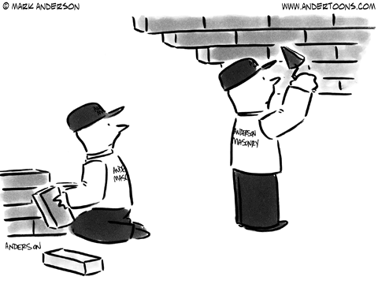
Top-down vs. and Bottom-up
Notes:
Monderman story

Slide 32
Complexity Policy focused on meta policy—influencing the economic environment
At the meta-level society must not only decide what role government should play in the economy, it must also decide what role government should play in designing the ecosystem within which the economy operates. It is government’s role in that design that is the focus of complexity policy. Should government try to influence the ecosystem so it evolves toward a system emphasizing more bottom-up solutions, or more top-down solutions? This presents an apparent contradiction: You need a strong government to design an ecosystem in which government intervention is limited. The stronger commitment a government has to complexity policy, the more conducive the ecostructure will be to bottom up control, and the less it can rely on top-down governmental control.
Another way to see the metapolicy role for government is as a policy opening up the institutional space in which individuals can coordinate their actions. Opening up new institutional space allows agents to develop new coordination institutions to better use the evolving technology. Government’s role here is to create an ecostructure or freedom that encourages the exploration of that new institutional space, and by doing so enlarging the solution space to make way for innovation.

Slide 33
The Complexity Policy Frame: The Economics of Influence, not Economics of Control
The complexity policy frame begins with the vision of the social system as a complex evolving system, where all elements of the social system coevolve, including government. This means that the system is continually in the process of reorganizing itself, undermining attempts to control it. It is shaped by the collective actions of agents within the system, but no agent has control. At best any agent, or an institution comprising of a collection of agents (including government) has a measure of influence. To gain insight into this complex social system, the complexity frame uses the tools of complexity science—fractal analysis, evolutionary game theory, non-linear dynamic models, and agent based models to study of the topography of policy. The information gained from that study is then used to guide policy makers with specific institutional knowledge to do the actual searching for policy in the dark.

Slide 34
Outline
Policy narrative lock-in and the Rise of Complexity Science
History of Economist’s Policy Narrative
An example of the type of policy initiatives that follow from the Complexity policy narrative.

Slide 35
Exploring the Institutional Space: An Example of a Policy that Follows from the Complexity Policy Framework
For benefit institutions
Owners of firms maximize social welfare, not profit.
Current framework provides polarization—for profit, not for profit and government
Changing the institutional structure to be more conducive to hybrid for benefit sector—smaller for profit market sector—smaller government sector.
Small changes in ecostructure can eventually lead to large changes in system.
Fourth Sector Movement in the U.S.

Slide 36
Example of Complexity Policy: For benefit institutions
Social Entrepreneurship and for-benefit enterprises
Firms should not, and do not Maximize Profit
They should maximize owner’s utility.
If that utility includes social goals,
Policy should be designed to encourage people to include social goals in the utility function.
Let me conclude with a presentation I gave at a Social Impact Summit at Harvard Law—done for non-economists.

Slide 37
For-Benefit
Economic Development
Dave Colander
Middlebury College
PART 3 – Economics Perspective

Slide 38
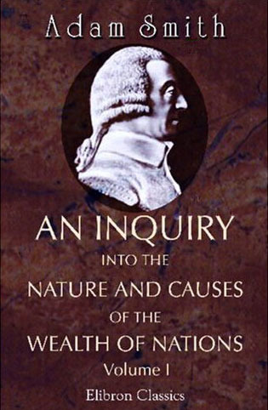
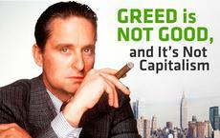
DOING WELL AND DOING GOOD
“It is not from the benevolence of the butcher, the brewer, or the baker that we expect our dinner, but from their regard to their own interest.”
--Smith, 1776
“It is not from the benevolence of good people that we will change society and achieve our social goals, but from their regard to their own self interest.”
--Smith updated

Slide 39
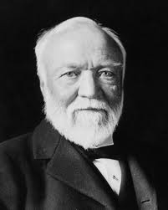
Andrew Carnegie and the Gospel of Wealth
This then is held to be the duty of the man of wealth. First: to set an example of modest, unostentatious living, shunning display; to provide moderately for the legitimate wants of those dependent upon him, and after doing so, to consider all surplus revenues which come to him simply as trust funds, which he is strictly bound as a matter of duty, to administer in the manner which in his judgment is best calculated to produce the most beneficial results for the community.

Slide 40
CLASSICAL ECONOMISTS SAW FOR-PROFIT CAPITALISM AS A STEPPING STONE, NOT AN END IN ITSELF
“When the accumulation of wealth is no longer of high social importance, there will be great changes in the code of morals. … All kinds of social customs and economic practices, affecting the distribution of wealth and of economic rewards and penalties, which we now maintain at all costs, however distasteful and unjust they may be in themselves, because they are tremendously useful in promoting the accumulation of capital, we shall then be free, at last, to discard.”
—J.M Keynes

Slide 41
ENTREPRENEURS WANT TO DO GOOD
FOR-BENEFIT FIRMS ALLOW THEM
TO DO IT MORE DIRECTLY.

Slide 42
BLENDING DOING GOOD WITH DOING WELL
The for-profit/not for profit divide conflicts students
For-Benefit corporations resolve the conflict.

Slide 43
FOR-BENEFIT CORPORATIONS BUILD SOCIAL GOALS INTO A COMPANY’S DNA

Slide 44
MILTON FRIEDMAN COULD SUPPORT FOR-BENEFIT FIRMS AS COULD ANY CLASSICAL LIBERTARIAN
If the corporate charter includes goals other than profit, then the goal of the corporation should be to achieve those other goals, not profit maximization.
The corporate charter is the DNA of the firm.

