Slide 1
The Moniac, Modeling, and Macroeconomics
David Colander
Middlebury College

Slide 2
“Today, if you ask a mainstream economist a question about almost any aspect of economic life, the response will be: suppose we model that situation and see what happens.” (Solow, 1997, 90)

Slide 3
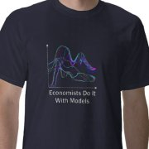
Models come in many shapes and sizes and have many uses

Slide 4
Some of Epstein’s 16 Uses of Models
pedagogical,
scientific,
policy,
exploratory,
metaphoric,

Slide 5
Classical economist’s use of models
Economics is a science of thinking in terms of models joined to the art of choosing models which are relevant to the contemporary world….Good economists are scarce because the gift for using "vigilant observation" to choose good models, although it does not require a highly specialized intellectual technique, appears to be a very rare one. (Keynes, 1938)
(An economist’s) conclusions, whatever be their generality and their truth, do not authorize him in adding a single syllable of advice. That privilege belongs to the writer or statesman who has considered all the causes which may promote or impede the general welfare of those whom he addresses, not to the theorist who has considered only one, though among the most important of those causes. The business of a Political Economist is neither to recommend nor to dissuade, but to state general principles, which it is fatal to neglect, but neither advisable, nor perhaps practicable, to use as the sole, or even the principle, guides in the actual conduct of affairs. (Senior 1836: 2-3)

Slide 6
Keynesian Economics and the Economics of Keynes
Moniac was not a model of the economics of Keynes; it was a model of (Neo) Keynesian Economics

Slide 7
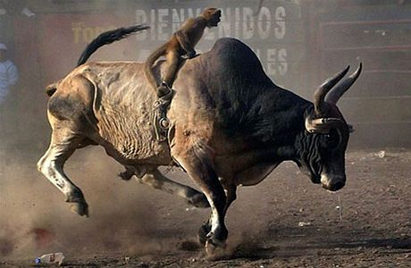
Keynesian Economics and the Economics of Keynes
Economics of control approach to policy (steering wheel)
vs.
complexity approach to policy.

Slide 8
Control vs. complexity approach to policy
Moniac was not a model of the economics of Keynes; it was a model of (Neo) Keynesian Economics
Economics of control approach to policy (steering wheel) vs. complexity approach to policy.

Slide 9
A change in the Use of Models and we moved from Classical to Neoclassical
Types of Optimal control models
IS/LM neoKeynesian synthesis
DSGE –New synthesis: Control model with forward looking agents
Complexity models: Agent based modeling—brings in non-linear dynamics, non solvable systems

Slide 10
The Need to consider non-linear dynamical models
In spite of the practical problems which remain to be solved, the ideas developed in this review have obvious applications in many areas. The most important applications, however, may be pedagogical.
The elegant body of mathematical theory pertaining to linear systems (Fourier analysis, orthogonal functions, and so on), and its successful application to many fundamentally linear problems in the physical sciences, tends to dominate even moderately advanced university courses in mathematics and theoretical physics. The mathematical intuition so developed ill equips the students to confront the bizarre behaviour exhibited by the simplest of discrete nonlinear systems, such as equation (3). Yet such nonlinear systems are surely the rule, not the exception outside the physical sciences….
Not only in research, but also in the everyday world of politics, and economics, we would all be better off if more people realized that simple nonlinear systems do not necessarily possess simple dynamical properties. (May, 467)

Slide 11
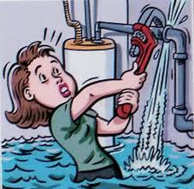
Policy in a Non-linear Moniac

Slide 12
Three Implications
To be useful, any model needs to come with a set of user instructions to make meaningful conclusions about the model’s usefulness.
Keynesian economics has been seriously misunderstood, both by neoKeynesians and lay people.
We need students to be trained in designing and thinking about those set of instructions as well as in technically modeling.

