Slide 1
Complexity and the Art of Public Policy Dave Colander Distinguished College Professor Middlebury College
Goal: to convince you that taking complexity seriously changes the way we think about economic policy.
Brief History of Economist’s Policy Narrative
Explain how the Complexity Policy Narrative Differs from the Current Economic Policy Narrative
Present some examples of the type of policy initiatives that follow from the complexity policy narrative.

Slide 2
What is Complexity Economics and how does it differ from Standard Economics?
Complexity economics involves thinking of the economy as a highly interrelated complex evolving system, and trying to understand it by discovering its replicator dynamics.
I use “complexity economics” as a catch all term to include the numerous changes that have occurred in in economics in the last 30 years. These include the introduction of behavior economics, bounded rationality, advanced statistical methods, experimental economics, institutional economics, ecological economics evolutionary economics, non linear dynamics, computational and based analysis, neuroeconomics to mention just some of them. Complexity is simply a general classifier of economic work to distinguish a modern economics that embraces, rather than one that excludes, all those approaches, or at most puts them in boxes.
Complexity economics is part of standard economics; it is just not the standard textbook economics that most of you will be acquainted with.
Textbooks lag the field. Standard economics has evolved enormously since the current textbook template was created about 70 years ago.
The economics profession is best seen as a complex adaptive system that evolves as analytic and computational technology changes.

Slide 3
What Caused the Change?
Complex evolving systems evolve, and as economics has evolved, so too has its policy analysis.
What drives the change is the changing analytic and computational technology.
The current textbook economics story reflects the analytic and computational technology of the 1940s. It fit well with multivariate calculus and control theory methods which shed light on a set of constrained optimization problems. These models don't fully capture modern economic thinking which is integrating new analytic and computational technology: Examples: Non linear dynamics and agent based modeling.

Slide 4
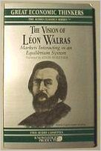
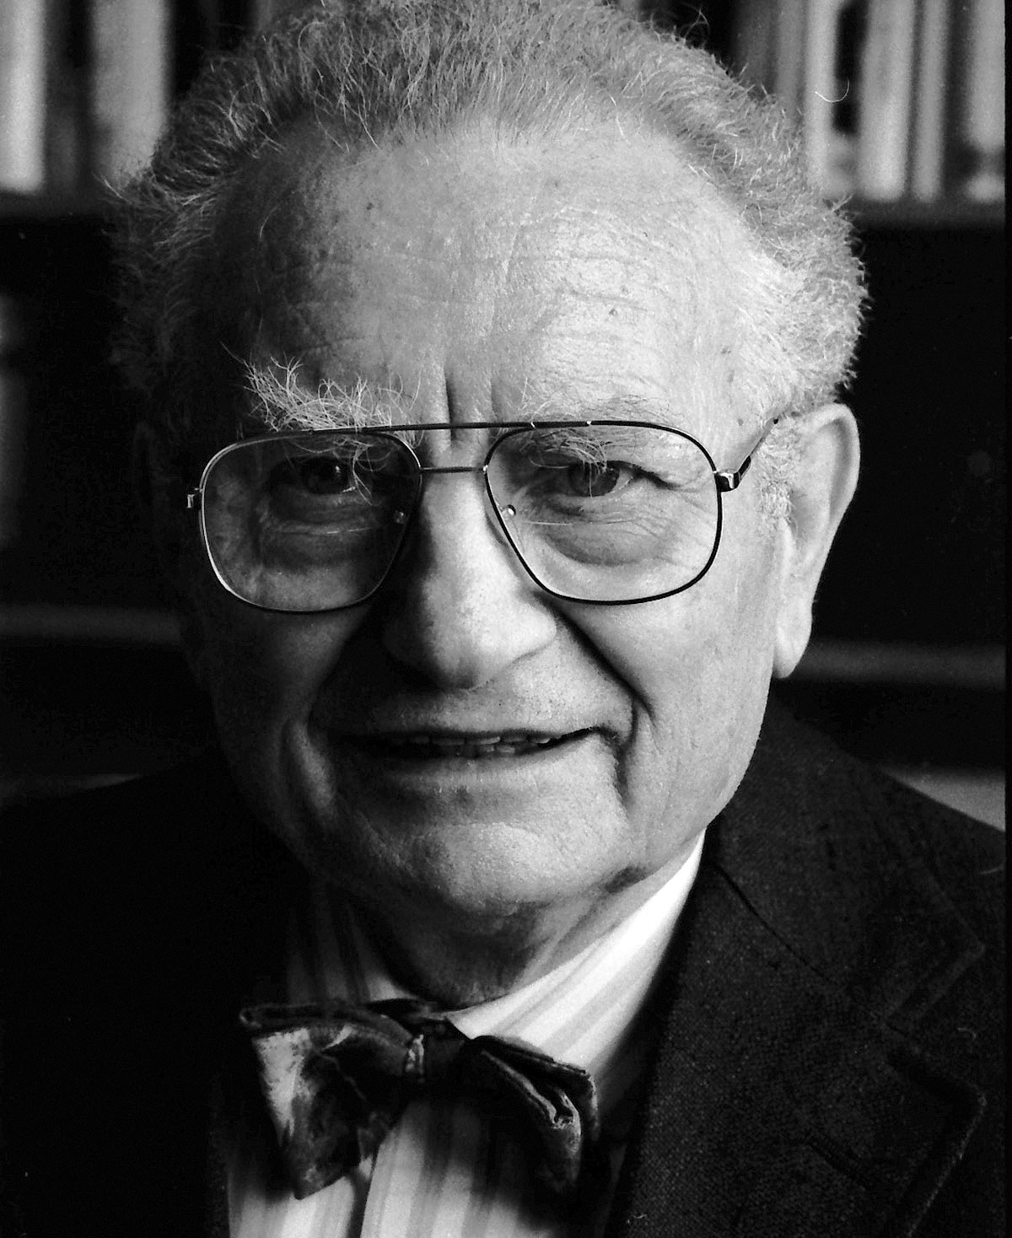
The focus of the textbook story has evolved over time and is still evolving. These changes are generally imperceptible as they occur. “Schools of thought” are designations that are put on by later writers that capture evolutionary changes.
Classical Economics 1776-1900 Adam Smith and Classical economics—a story of a complex economy in words A humble approach to policy—laissez faire policy reflected lack of knowledge.
Neoclassical economics 1900--2000 supply demand forces story in solvable equations. Optimal control frame. Primarily deductive: dependent on stung assumptions: ultra rationality, unique equilibrium, exogenous tastes, highly simplified institutions, uncertainty can be reduced to risk.
Complexity economics 2000--? Classical economics with new analytic and computational technology. --a story of a complex economy in “algorithmic equations.” Computational based—a blend of induction and deduction. It tells stories, not truth. The economy is a complex evolving system that cannot be fully understood, but light can be shed on it by studying the replicator dynamics—the simple process of change—biological underpinnings. Search is for those local institutionally based rules agents follow, and how they institutions they build up to handle problems in coordinating with others.

Slide 5
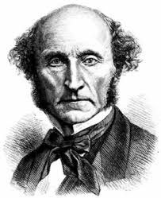
The Dominant Classical Policy Narrative: The Invisible Hand
No formal general model of the economy
Science and policy interrelations too complicated for complete models
Mills “Theory and Half Truths” Approach: Policy needs integration into broader social and ethical considerations than can be achieved by formal models: Precepts and Theorems
Strict Separation of policy from theory and models
In particular instances, models useful as tools for solving particular problems, but need to keep broader considerations in the back of one’s mind.
Policy: Classical liberal—freedom of individual; government should stay out of people’s lives.
Notes:
No formal general model of the economy and no direct connection between science and policy--interrelations too complicated—they had a general vision.
Policy was to come from broader considerations—Classical economists differentiated precepts—policy prescriptions including all considerations, and theorems—results of formal theorizing—no direct relevance for policy
In particular instances, economic reasoning may dominate, and economists Models as tools for solving particular problems.
Mathematics and formal models are downplayed—Marshall’s Dictum—burn the mathematics.

Slide 6
Classical Economist’s Policy Narrative
(An economist’s) conclusions, whatever be their generality and their truth, do not authorize him in adding a single syllable of advice. That privilege belongs to the writer or statesman who has considered all the causes which may promote or impede the general welfare of those whom he addresses, not to the theorist who has considered only one, though among the most important of those causes. The business of a Political Economist is neither to recommend nor to dissuade, but to state general principles, which it is fatal to neglect, but neither advisable, nor perhaps practicable, to use as the sole, or even the principle, guides in the actual conduct of affairs. (Senior 1836: 2-3)

Slide 7
The current “neoclassical’ textbook economics story
Economics of Control Narrative: Constrained optimization, Max U
The Wonders of Voluntary Trade-the invisible hand is there, but not emphasized much
Subject to certain assumptions, the market will achieve desirable Pareto optimal outcomes
Government ‘s role is to allow the market to do what it can, and to maximize social welfare by correcting for market failures—externalities, monopolies with taxes and other control mechanisms.
These can be analyzed through formal models, and one draws policy conclusions from the models.
It is an Activist Policy Story—government action is needed to maximize social welfare.
Idealized Market result is reference point for policy. Were it not for market failures, the market result would be what we want.

Slide 8
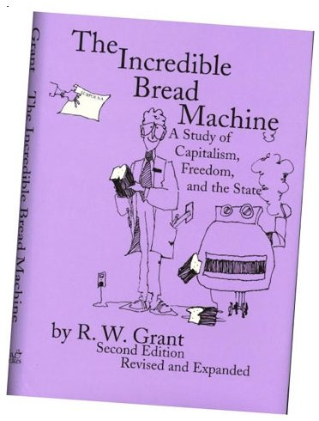
The Market Fundamentalist Alternative
These are stories of I Pencil and the Incredible Bread Machine, which relate to but do not capture classical economic policy thought.
Fundamentalist Policy advice—leave everything to the market. Keep government out. The market handles complexity.

Slide 9
Textbooks lean toward the Control Policy Alternative
Textbooks, such as mine, try to walk between the two. (because we want to sell books)
Designed around “control model” but with some addenda
Accepts that people are rational, utility maximizers, and firms are profit maximizers
Policy Debate is between Government Failure and Market Failure. Empirical evidence generally too weak to answer it so debate is unresolved in practice, but in principle, it could be resolved. So you frame the issue as a maximization problem with a controller.

Slide 10
What got pushed out of the policy story
Neither side questioned how morality fit into the policy discussion. Discussions of morality and of the ethical goals of society and how they related to economic policy became removed from the standard economic discussion of policy.
Argument for the market was never efficient—it was moral and pragmatic
Adam Smith wrote the theory of Moral Sentiments before he wrote the Wealth of Nations
Neither side questioned the role of norms in policy. Instead both sides of the argument accepted that norms were not part of the debate. This is where the contribution of the other social sciences is sorely missed.
Neither side questioned how the activities that individuals undertook could feed back on what the people wanted and shape them as a person. Both sides assumed that people had well-formed tastes and that the tastes are not affected by what they do or their context. That just isn’t true—what we want is influenced by the system, and any policy advice would have to take into account the degree to which that occurs. This opens up a whole range of policy actions that are generally not considered.
Neither side questioned the problems with material welfare as a measure of welfare—problems that were much on the minds of Mill, Marshall and Pigou. Whereas before economists separated economic welfare and social welfare, after the acceptance of these two models, they no longer did. Economist’s discussion of policy started talking as if material welfare were everything.
Neither side of the debate dealt with the problem of structure of existing institutions; both assumed them as given. The idea that the very structure of government, or of private institutions, can be a problem was not part of the frame of this polarized debate.

Slide 11
The complexity policy frame alternative
“Market” is not an abstract gentility, but an institutional form that has infinite variety, and can only be understood jointly with government and existing norms and culture.
The government policy role that the complexity frame focuses on is the role in the formation of institutions—influence not control. Creating the best ecology to allow individuals to solve problems.
Both the government and the market are institutional creations of society. They have co-evolved to solve difficult coordination problems. The strict separation of market from government loses this interrelationship. Any market requires government or culture to operate. Government influence property rights, regulations, culture, legal structure.
Activist Laissez Faire Policy
The focus of complexity policy is on evolving systems and formation, not on allocation, given institutions, as in the standard frame.
Far fewer assumed constants: Norms become endogenous, property rights endogenous, tastes endogenous, institutions endogenous. These are all issues that modern economics is looking at. Example: Behavioral economics

Slide 12
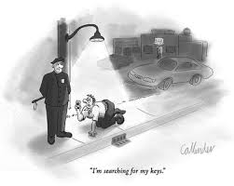
The Complexity Policy Framework
The general model is too complicated to solve so in the complexity policy frame one has no general theory to rely on. The models are not enough.
Government has coevolved with the economy and cannot be viewed separately from the market.
Social norms co-evolve
There is no different fundamentalist and standard policy narrative
Mathematics and formal models are center stage, but are used a guides, for policy.
Matching models to problems—searching for the policy keys

Slide 13
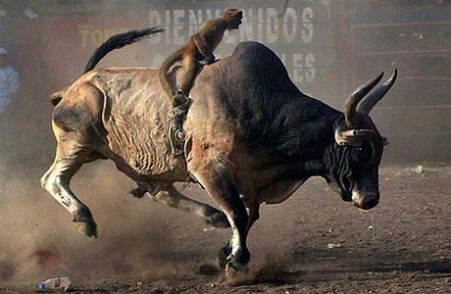
Role of Government in the Control and the Complexity Frames Control vs. Influence

Slide 14
Complexity Frame focuses on Problems of Formation; Standard Frame focuses on Problems of Allocation
Government’s complexity policy goal is to positively influence the evolution, not to control systems
Basics of Complexity Policy
Market result does not serve as a normative reference point. That must be part of the analysis.
Appeal to Adam Smith’s “Impartial Spectator” What would someone behind a veil of ignorance view the policy change?
Comparative institutional analysis
The advantage of the existing system is that it “works” however badly. Not sure that new arrangements will work.
Policy questions: What is the nature of optimal property rights? Can we positively influence their evolution? Does the existing system fulfill our true needs, or does it simply create needs and then fulfill them?
Formation policy: Choosing among many equilibria; Allocation policy: trying to improve existing equilibrium.

Slide 15
Economic Policy Approaches and Medical policy
Standard policy like standard medicine: drug based: Find a drug to solve the problem
Complexity Policy is the equivalent to a blend of Genetic Medicine: and holistic medicine.
Less intervention into actual issues, but attempt to influence results by creating preferable ecostructure.
Since things evolve—try to affect things early before they become built into the system.

Slide 16
How can government have a positive influence?
Encourage self-interested norms, not selfish norms.
If society is to be moral, individuals need to be moral. Adam Smith recognized this—Theory of Moral Sentiments
How selfish soever man may be supposed, there are evidently some principles in his nature, which interest him in the fortune of others, and render their happiness necessary to him, though he derives nothing from it except the pleasure of seeing it. Of this kind is pity or compassion, the emotion which we feel for the misery of others, when we either see it, or are made to conceive it in a very lively manner. That we often derive sorrow from the sorrow of others, is a matter of fact too obvious to require any instances to prove it; for this sentiment, like all the other original passions of human nature, is by no means confined to the virtuous and humane, though they perhaps may feel it with the most exquisite sensibility. The greatest ruffian, the most hardened violator of the laws of society, is not altogether without it.--Smith

Slide 17
Complexity Policy focused on meta policy—influencing the economic environment
At the meta-level society must not only decide what role government should play in the economy, it must also decide what role government should play in designing the ecosystem within which the economy operates. It is government’s role in that design that is the focus of complexity policy.
Complexity policy opens up the institutional space within which individuals can coordinate their actions to better use the evolving technology. Government’s role here is to create an ecostructure or freedom that encourages the exploration of that new institutional space, and by doing so enlarging the solution space to make way for innovation.

Slide 18
Complexity frame opens new policy options
Economics of influence, not economics of control—since government and market have coevolved, and are interrelated, there is no outside controller.
Policy is discussed as social policy—goes beyond economics, not economics policy; the two are inseparable.
Policy focuses on changing institutions rather than just incentives. Incentives are embedded in institutions.
An important role of policy is to allow exploration of institutional space and open up new areas for social entrepreneurs to populate.
Policy is time and position sensitive. Focus on lock-in and tipping points—there is a right time and a right place for policy.

Slide 19
Some Complexity Distribution Policies to Explore
Property rights could have a more limited duration than they currently have. Patent and copyright laws could be designed for much shorter periods, so that the benefits of the work are passed to the broader public.
Intellectual property rights could be significantly limited.
Institutions favoring open source software and material could be institutionally encouraged.
Instead of perpetuity property rights in land, 100 year leases could have been given, with the land reverting to social wealth, and re-leased, when the lease comes due.
Competition could be more strongly supported by limiting government supported monopolies.
Regulatory structures of institutions could allow for narrower specialists, so that the rents created are spread more widely and more competition is created.
Open certification not requiring specific high-priced formal training programs, but rather “open-to anyone” certification exams, could be instituted.
At risk students could be provided with a “bottom-up” educational option, in which, they receive the money that would have gone into educating them if they learn the material on their own.
Individual’s social, not materialistic, proclivities could be encouraged.
The society could advocate and support a stronger tradition of social responsibility of the rich, so that achieving social goals becomes a favored luxury good of the rich. Andrew Carnegie’s Gospel of Wealth could be built into the fabric of society.
Institutions could have been designed to encourage social benefit, rather than private benefit, entrepreneurship.
Materialism embedded in the GDP goals could be countered by replacing GDP with other measures of social success such as Sen’s Capabilities Index.

Slide 20
John Stuart Mill’s Defense of Private Property
The laws of property have never yet conformed to the principles on which the justification of private property rests. They have made property of things which never ought to be property, and absolute property where only a qualified property ought to exist. They have not held the balance fairly between human beings, but have heaped impediments upon some, to give advantage to others; they have purposely fostered inequalities, and prevented all from starting fair in the race. That all should indeed start on perfectly equal terms, is inconsistent with any law of private property; but if as much pains as has been taken to aggravate the inequality of chances arising from the natural working of the principle had been taken to temper that inequality by every means not subversive of the principle itself; if the tendency of legislation had been to favor the diffusion, instead of the concentration of wealth—to encourage the subdivision of the large masses, instead of striving to keep them together—the principle of individual property would have been found to have no necessary connection with the physical and social evils which almost all Socialist writers assume to be inseparable from it.

Slide 21
An Example of Non optimal Property rights
The Mickey Mouse Protection Act, also called the Copyright Term Extension Act (CTEA) of 1998; it extended copyright in the United States to last for the life of the author plus 70 years and for works of corporate authorship to 120 years after creation.
Such long Copyrights don’t make sense
Daniel Pink’s Drive —economic incentives are only a small part of the motivating factors.
Drug and patent law. Patent trolls. Channel income to middlemen, not to producers.
Doctorow’s Information Doesn’t Want to be Free — argues that artists would be better with no copyrights
Moldrin and Levin’s —we’d be better off without patents and copyrights.

Slide 22
Complexity Policy is an Activist Laissez Faire Policy
Activist laissez faire policy is a policy designed to create a viable ecostructure in which individuals solve social problems from the bottom up, without the use of a central coordinator. As opposed to imposing social goals on people top down, activist laissez faire policy is a bottom up policy that focuses on creating an ecosystem that encourages people’s social dimension to direct their day to day interactions, rather than relying on a system that encourages them to rely on their more selfish dimension in guiding their actions.

Slide 23
Creating an ecostructure conducive to social goals: For benefit institutions
Social Entrepreneurship and for-benefit enterprises
Even if one agrees with Milton Friedman that firms should be responsive to its owner’s wishing, firms should not, and do not Maximize Profit
They should maximize owner’s utility.
If that utility includes social goals, policy should be designed achieve the social goals owners are interested in.
What do you do if you’ve made $30 million at 30?

Slide 24
CLASSICAL ECONOMISTS SAW FOR-PROFIT CAPITALISM AS A STEPPING STONE, NOT AN END IN ITSELF
“When the accumulation of wealth is no longer of high social importance, there will be great changes in the code of morals. … All kinds of social customs and economic practices, affecting the distribution of wealth and of economic rewards and penalties, which we now maintain at all costs, however distasteful and unjust they may be in themselves, because they are tremendously useful in promoting the accumulation of capital, we shall then be free, at last, to discard.”
—J.M Keynes

Slide 25
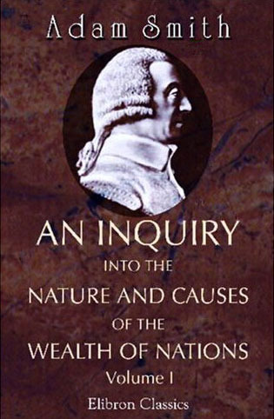
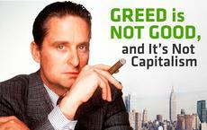
DOING WELL AND DOING GOOD
“It is not from the benevolence of the butcher, the brewer, or the baker that we expect our dinner, but from their regard to their own interest.”
--Smith, 1776
“It is not from the benevolence of good people that we will change society and achieve our social goals, but from their regard to their own social self interest.”
--Smith updated

Slide 26
FOR-BENEFIT CORPORATIONS BUILD SOCIAL GOALS INTO A COMPANY’S DNA

Slide 27
MILTON FRIEDMAN COULD SUPPORT FOR-BENEFIT FIRMS AS COULD ANY CLASSICAL LIBERTARIAN
If the corporate charter includes goals other than profit, then the goal of the corporation should be to achieve those other goals, not profit maximization.
The corporate charter is the DNA of the firm.

Slide 28
ENTREPRENEURS WANT TO DO GOOD
FOR-BENEFIT FIRMS ALLOW THEM
TO DO IT MORE DIRECTLY.

Slide 29
Principles Based Regulation
Rule based regulation—telling people what to do.
It follows from standard policy because people are assumed selfish.
Principles based regulation—general goals of regulation spelled out, with individual left to figure out how best to implement it. Requires socially minded individuals and good will.

