Slide 1
Compulsory Licensing: Evidence from the Trading with the Enemy Act
Moser and Voena
AER 2012

Slide 2
Research Question: How does compulsory licensing of patents affect subsequent innovation by firms in the chemical sector?
What are the channels through which the effect operates: e.g. knowledge spillovers, learning by doing, broader education and upskilling of scientists due to knowledge spillovers, others?
Empirical Implementation: Studies the TWEA in 1917 which confiscated German (and other Axis power) chemical patents and passed them to the US Chemical Foundation for on-licensing to US firms – the “treated patent subclasses”. Diff-in-Diff analysis comparing subsequent patenting in the treated group with subclasses where no licensing occurred.
Main identification issue:
1. Was licensing (“treatment) random, or was it in areas where US firms were weak before TWEA and/or where demand for domestic chemical patents was stronger?

Slide 3
Data:
Treatment group: 727 enemy-owned chemical patents licensed to at least one of 326 U.S. firms from 1919-1926. They belong to 336 primary and secondary subclasses.
Most subclasses received one license, but some more (Figure 2)
Remaining life of patents licensed varied (Figure 3)
Outcome: 129k US patents 1875-1945 in 19 patent classes within chemicals that received at least one compulsory license under TWEA
Comment: M&V assume that the effect of license in subclass j is only on later innovation in that subclass. No consideration of potential spillovers to other (related) subclasses. Could address exploiting Mahalonobis proximity measure for subclasses (as in BSV, 2013)

Slide 4
German patenting rebounded after WWI, but less rapidly in the treated classes.

Slide 5
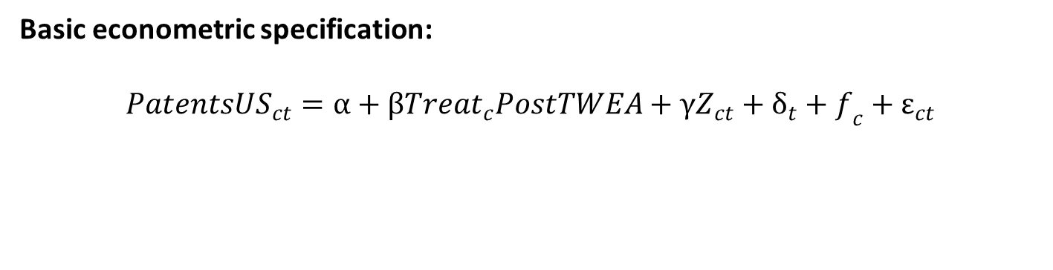
Basic econometric specification:
$$Patents{US}_{ct}=α+β{Treat}_{c}PostTWEA+γZ_{ct}+δ_{t}+f_{c}+ε_{ct}$$

Slide 6
Concern: Weakened German competition after 1914 may have had larger effect on treated subclasses (where they were patenting) so we may overestimate the effect of compulsory licensing on invention.
But Figure 1 shows rebounding of German patenting in both treated and control subclasses (but does it appear the same for both groups?).
By 1921 German competition was re-established.

Slide 7
When did the effect set in? Modify DID specification to capture annual effects pre-and post-TWEA interacted with Treat dummy. Pre-TWEA trends equal? When was the break?

Slide 10
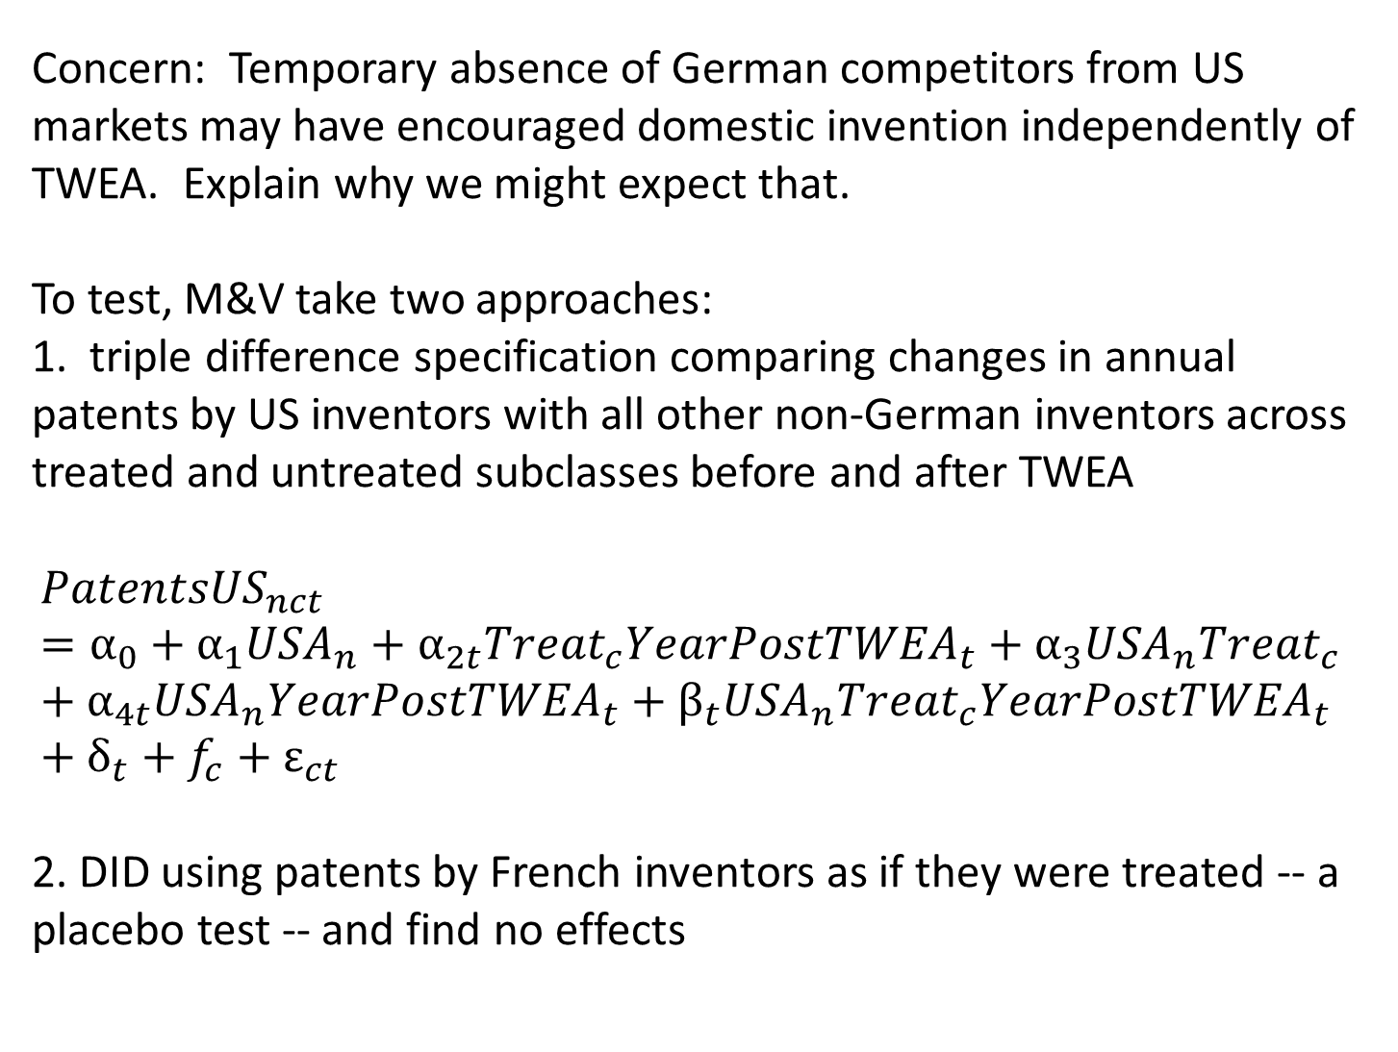
Concern: Temporary absence of German competitors from US markets may have encouraged domestic invention independently of TWEA. Explain why we might expect that.
To test, M&V take two approaches:
1. triple difference specification comparing changes in annual patents by US inventors with all other non-German inventors across treated and untreated subclasses before and after TWEA
$$Patents{US}_{nct}=α_{0}+α_{1}{USA}_{n}+α_{2t}{Treat}_{c}{YearPostTWEA}_{t}+α_{3}{USA}_{n}{Treat}_{c}+α_{4t}{USA}_{n}{YearPostTWEA}_{t}+β_{t}{USA}_{n}{Treat}_{c}{YearPostTWEA}_{t}+δ_{t}+f_{c}+ε_{ct}$$
2. DID using patents by French inventors as if they were treated -- a placebo test -- and find no effects

Slide 12
Use number of enemy patents as IV for licensed patents. Highly correlated and should not affect domestic invention directly (unless via competition?)

