Slide 1
Climbing atop the Shoulders of Giants: The Impact of Institutions on Cumulative Research Furman and Stern AER 2011

Slide 2
Research Question: How do biological resource centers (BRCs) affect knowledge accumulation, controlling for any selection (e.g., on quality of research materials)? Does the impact differ across types of subject matter and quality of scientific journals with which the biomaterials are associated? Empirical Implementation: Study biomaterial deposits into US American Type Culture Collection (ATCC). They are associated with specific scientific articles, and FS study citations to those papers before and after deposit, against a control sample. DID estimation using Negative Binomial count model. Main identification issue: Endogenous deposit decisions: This selection into BRCs presumably is based on value added to the one depositing it which may be related to quality of research (but is it obvious which direction?)

Slide 3
Ways in which BRCs can promote cumulative research: 1. Certification: biomaterials authentication 2. Independent and open access to biological materials 3. Preservation of biological materials 4. Scale and scope economies: lower the cost of follow-on research Four Predictions to be tested: 1. Knowledge associated with BRCs will be of higher scientific value than that available only through other (e.g. peer to peer) channels 2. Controlling for importance of the discovery, BRC should increase knowledge diffusion 3. Impact of BRC will be greater for knowledge associated with “poor” institutional environments 4. Impact of BRC greater among researchers/projects where authentication and independent access are more valuable

Slide 4
Data: ATCC identifies the key scientific article employing/characterising the deposited material Exploit mass transfer of three special collections into ATCC, which are matched to 108 articles in total (Human Tumor Bank, Tumor Immunology Bank, and Gazdar collection) Control group = “most related” article in same volume of the journal where BRC article published (using a search text-based algorithm) Table 2B and Figure 1 for comparison of BRC and control groups

Slide 5
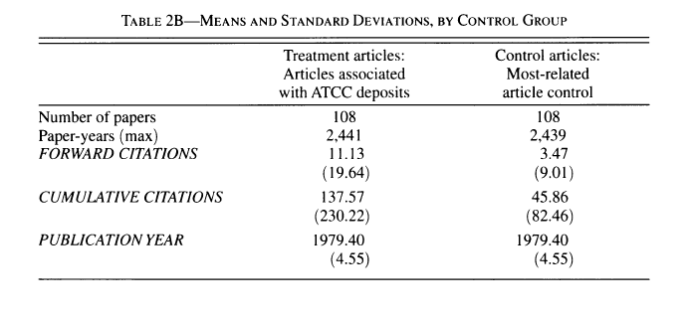

Slide 6
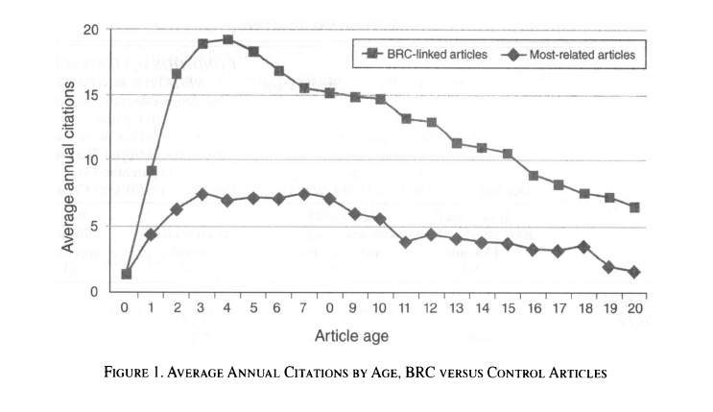

Slide 7
Empirical specification: $${ForwardCites}_{ijt}=f(α_{j}+β_{t}−δ_{t−pubyear}+φ{BRCArticle}_{i}$$ $+ψ{BRCArticlexWindow}_{it}$+$ϴ{BRCArticlexPostDeposit}_{it}$) where $α_{j}$ is a fixed effect for each pair of treatment and control articles. The interaction with Window picks up announcement effects (window of BRC deposit plus/minus one year), and PostDeposit picks up the post period after that. Tables 3 and 4 here

Slide 8
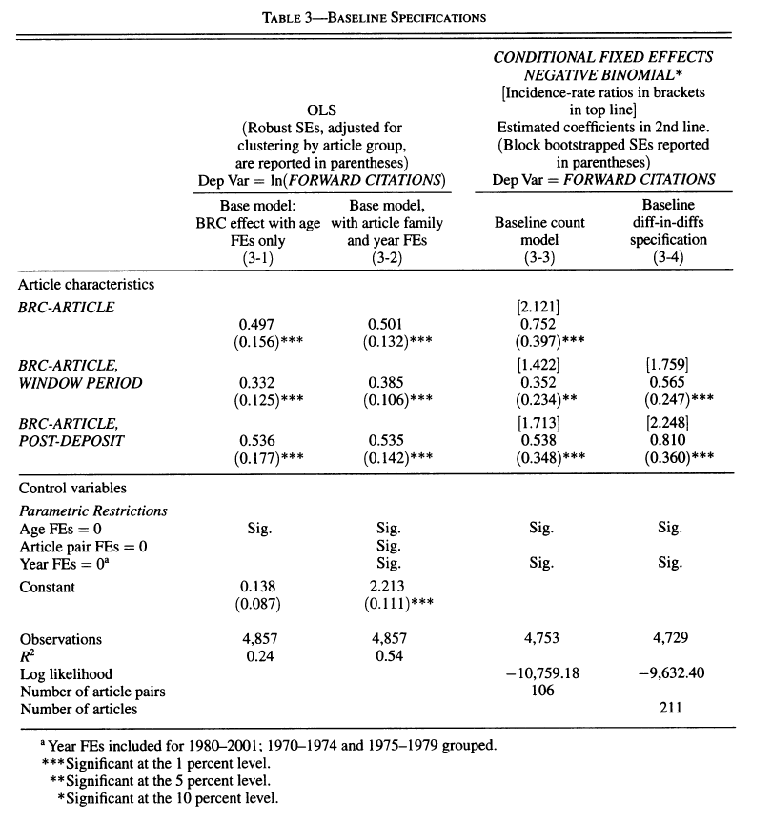

Slide 9
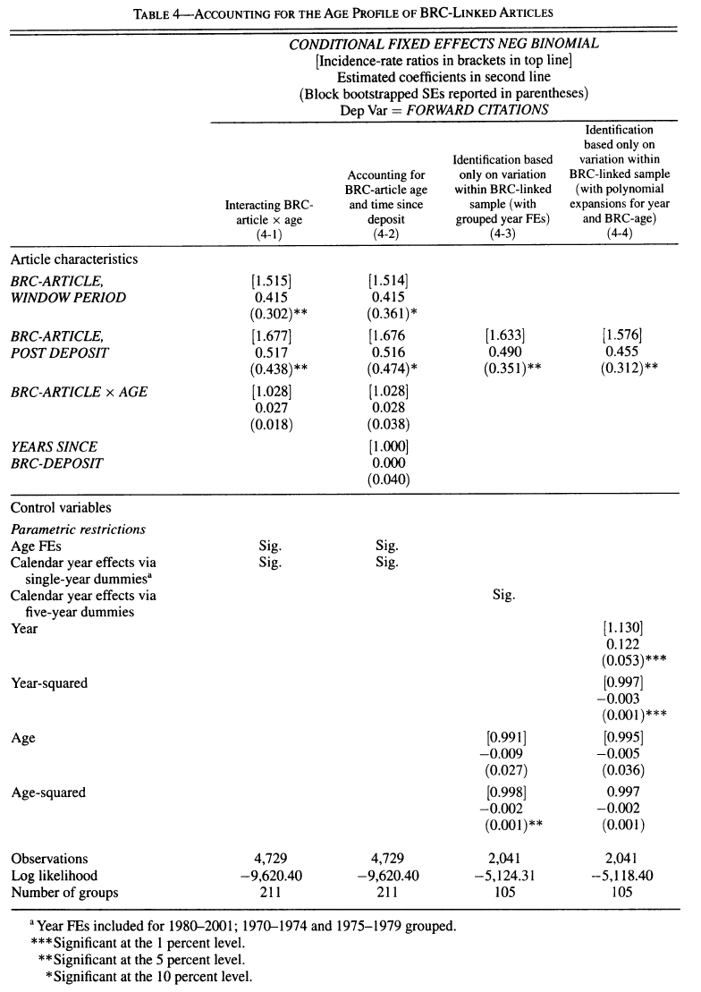

Slide 10
Other Hypotheses: 1. Substitution: higher citation of BRC articles at the expense of lower citation of “most related own article”. (why only own articles?) Finds those cites also rise after BRC deposit, by about same amount! 2. Where quality certification is more important (articles in lesser journals), we expect BRC effect to be larger; it is (col. 6-1, Table 6) 3. More evidence is gotten by considering cites by separate subpopulations. Table 7A shows that cites jump more by articles in top journals and articles with multiple subject fields (harder to secure all necessary rights?) 4. Table 8 provides some rough comparison of the cost effectiveness of BRC in generating extra citations relative to public funding of additional research (but the latter provides new knowledge too)

Slide 11
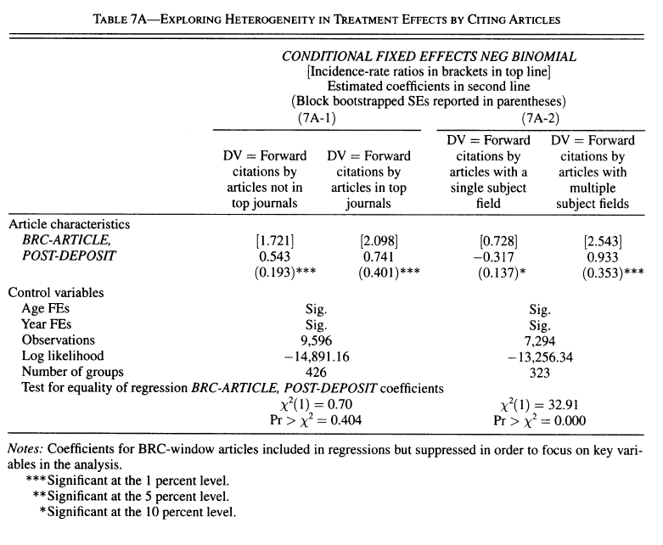

Slide 12
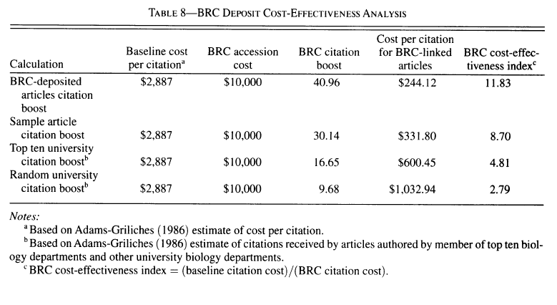

Slide 13
Intellectual Property Rights and Innovation: Evidence from the Human Genone Heidi Williams JPE 2013

Slide 14
Research Question: How does contract-based IP on genes affect subsequent innovation on human genome, measured in terms of later scientific publications and product development based on focal genes? Empirical Implementation: During 2001-03 Celera had contract-based IP (not a patent) on genes it sequenced but that were known to be sequenced by the public Human Genome Project and be in public domain by 2003 (note: this would be expected to affect strongly licensing terms/bargaining failure?). Williams traces gene-phenotype links, and gets all later publications and diagnostic tests developed on basis of these links. Asks whether removal of “IP” in 2003 raised these measures of research and product development. Main identification issue: Celera genes may have been lower (higher) quality which can explain less (more) follow-on research/products based on them.

Slide 15
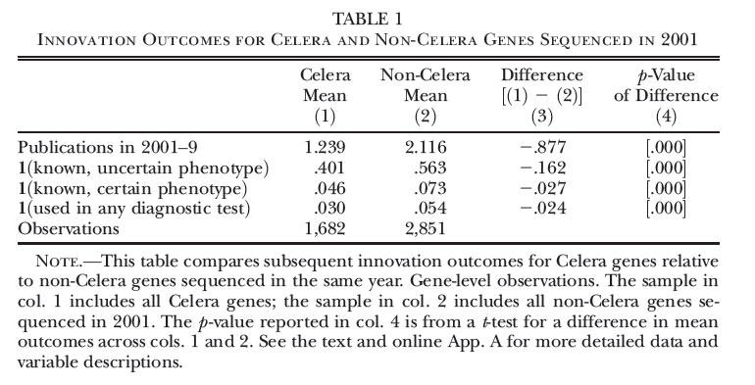

Slide 16
1. Comparisons in Figure 3 indicates selection: Celera genes of lower quality than others – i.e. fewer mean publications based on Celera genes. But after 2001 there is no evidence of selection, so Williams focuses her cross sectional regression on genes sequenced in 2001 Figure 3 here Cross-sectional specification: ${Outcome}_{g}=α+β{Celera}_{g}+λ^{′}X_{g}$+ ${\text{ε}}_{g}$ Table 3 here 1. Significant negative impact of Celera: Publications: 10-15% decline (columns 2 and 3) Phenotype products: 20-35% Diagnostic tests: 20-25%

Slide 17
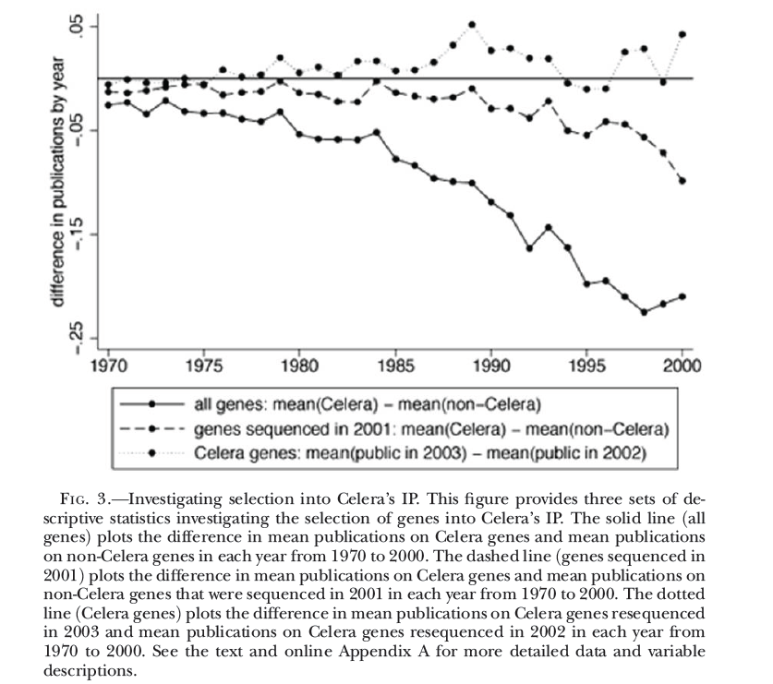

Slide 18
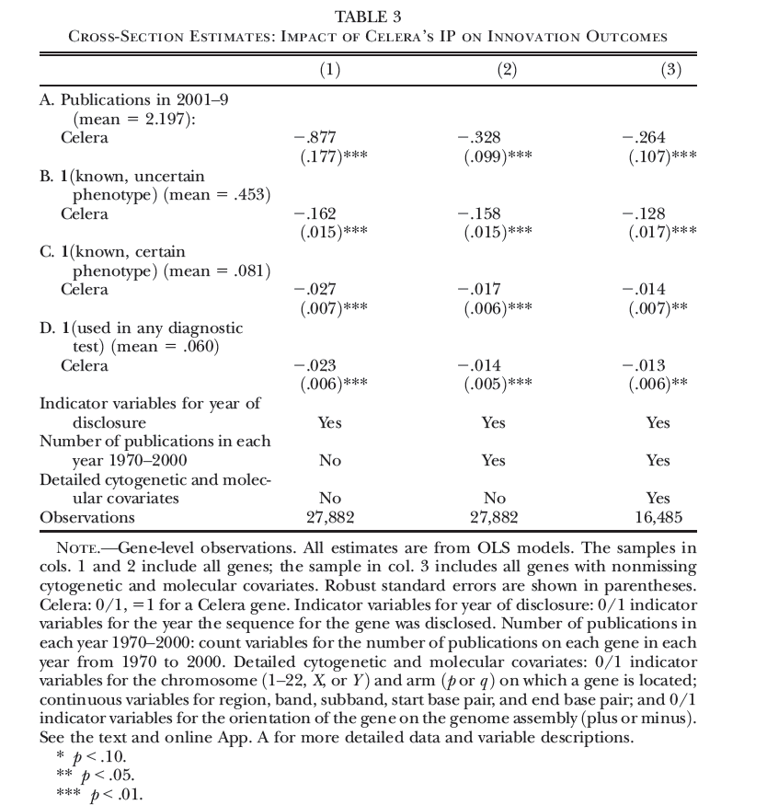

Slide 19
Panel empirical specification: ${Outcome}_{gy}=α+δ_{g}+ϴ_{y}+β{Celera}_{gy}+$ ${\text{ε}}_{gy}$ where Celera dummy is 1 when the gene has only been sequenced by Celera, and zero when also by public effort. Table 4 here 1. Significant negative impact of Celera: Publications: 45-50% decline (columns 2 and 3) Phenotype products: 20-40% decline

Slide 20
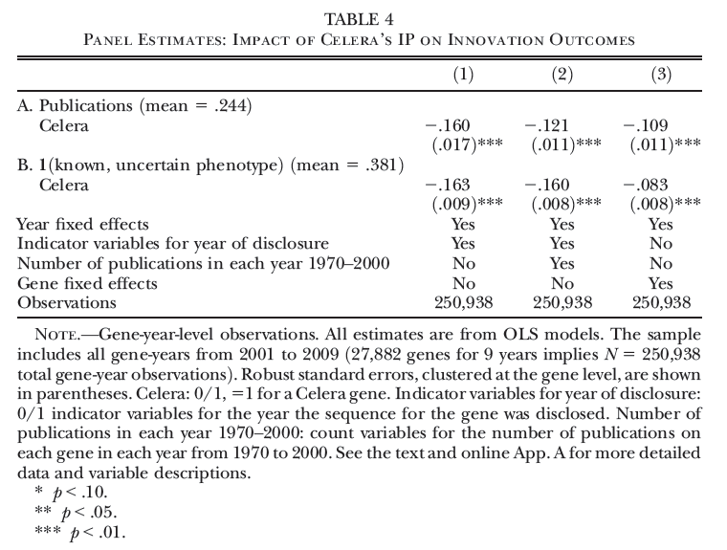

Slide 21
Panel specification with timing of effects: ${Outcome}_{gy}=α+δ_{g}+ϴ_{y}+Σ_{z}β_{z}{Celera}_{g}xI(z)+$ ${\text{ε}}_{gy}$ z is a year count before/after removal of IP to trace time pattern of effects, and Figure 4 here 1. For both publications and indicator of whether there was any phenotype product (not the count of products), there is a sharp break in flow right after last year of Celera IP. Extra flow roughly constant for publications but for phenotype links it grows over time. (Would help to see longer period before the last year to confirm zero effects)

Slide 22
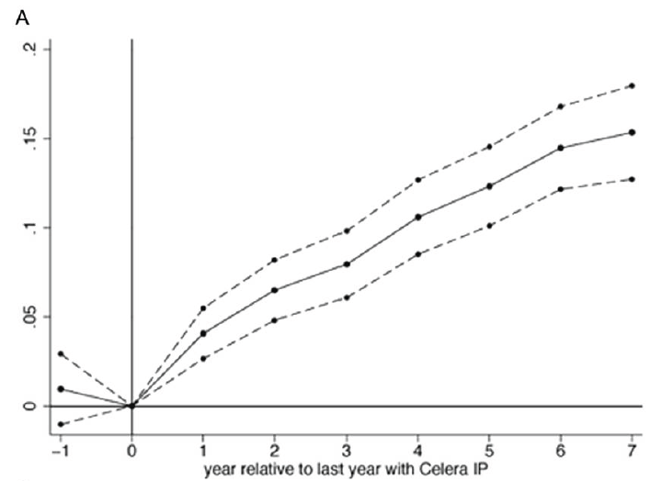
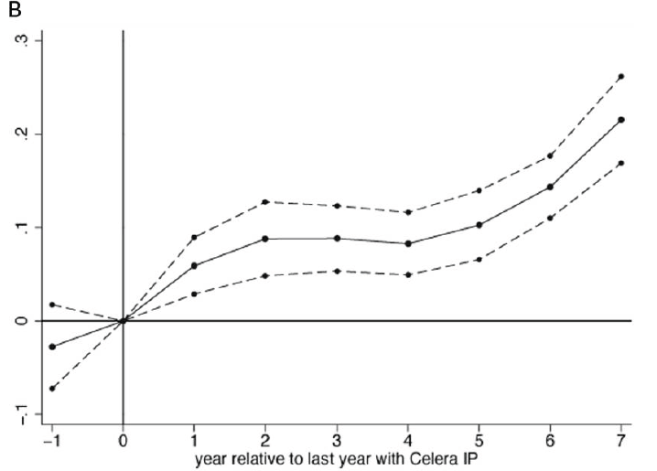

Slide 23
Discussion of Transaction Costs: Why does IP “block” follow-on (downstream) innovation? 1. Green and Scotchmer: Coasian world with perfect information and no transaction costs. Efficient bargaining always occurs, though terms of the bargain (license) depend on strength of patent rights 2. Bargaining failure: This can arise from two main sources: a) asymmetric information: one party cannot convey the private information credibly or risks the invention being expropriated if the information is disclosed – “Arrow paradox of information” b) complements problem: royalty stacking (if other patented inputs are needed) – uncoordinated bargaining can kill a project

